Slide 1

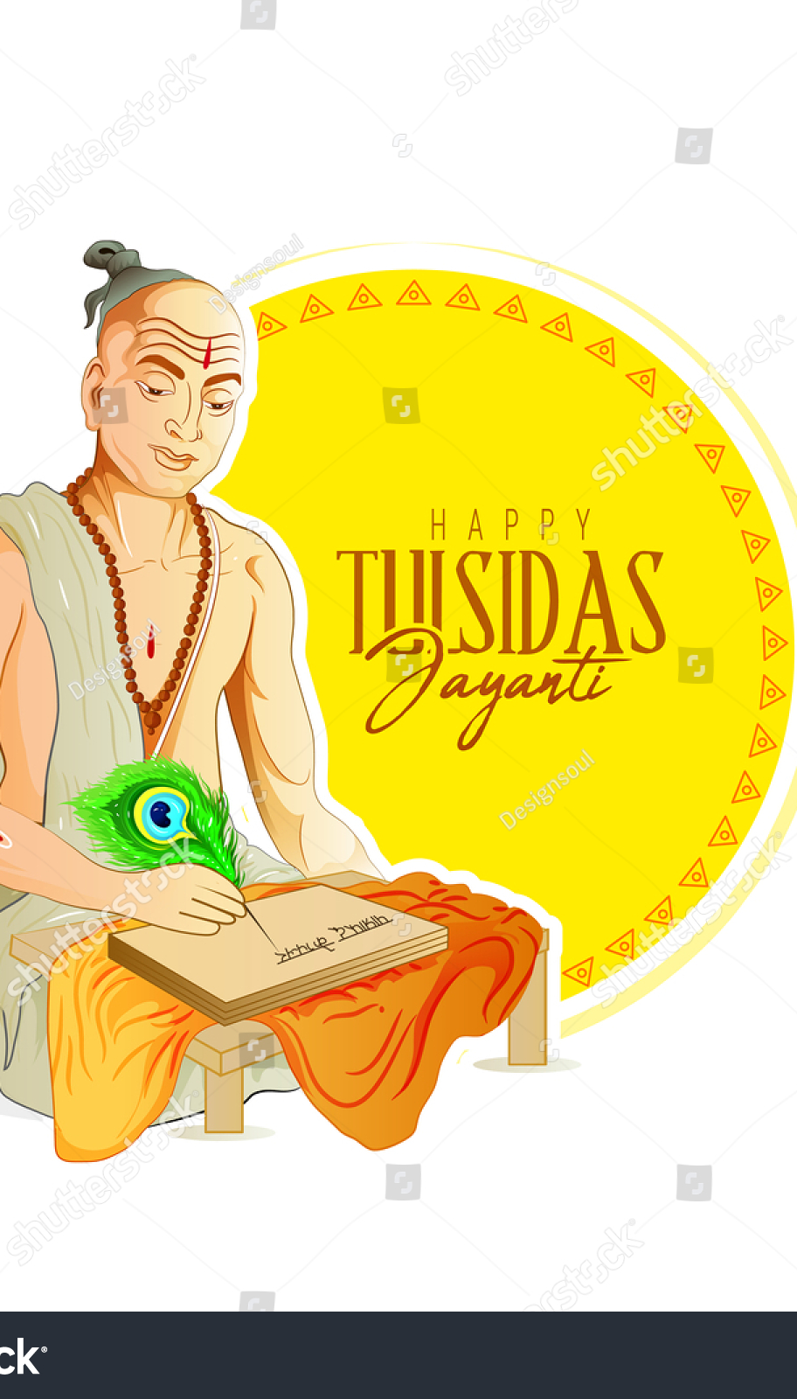
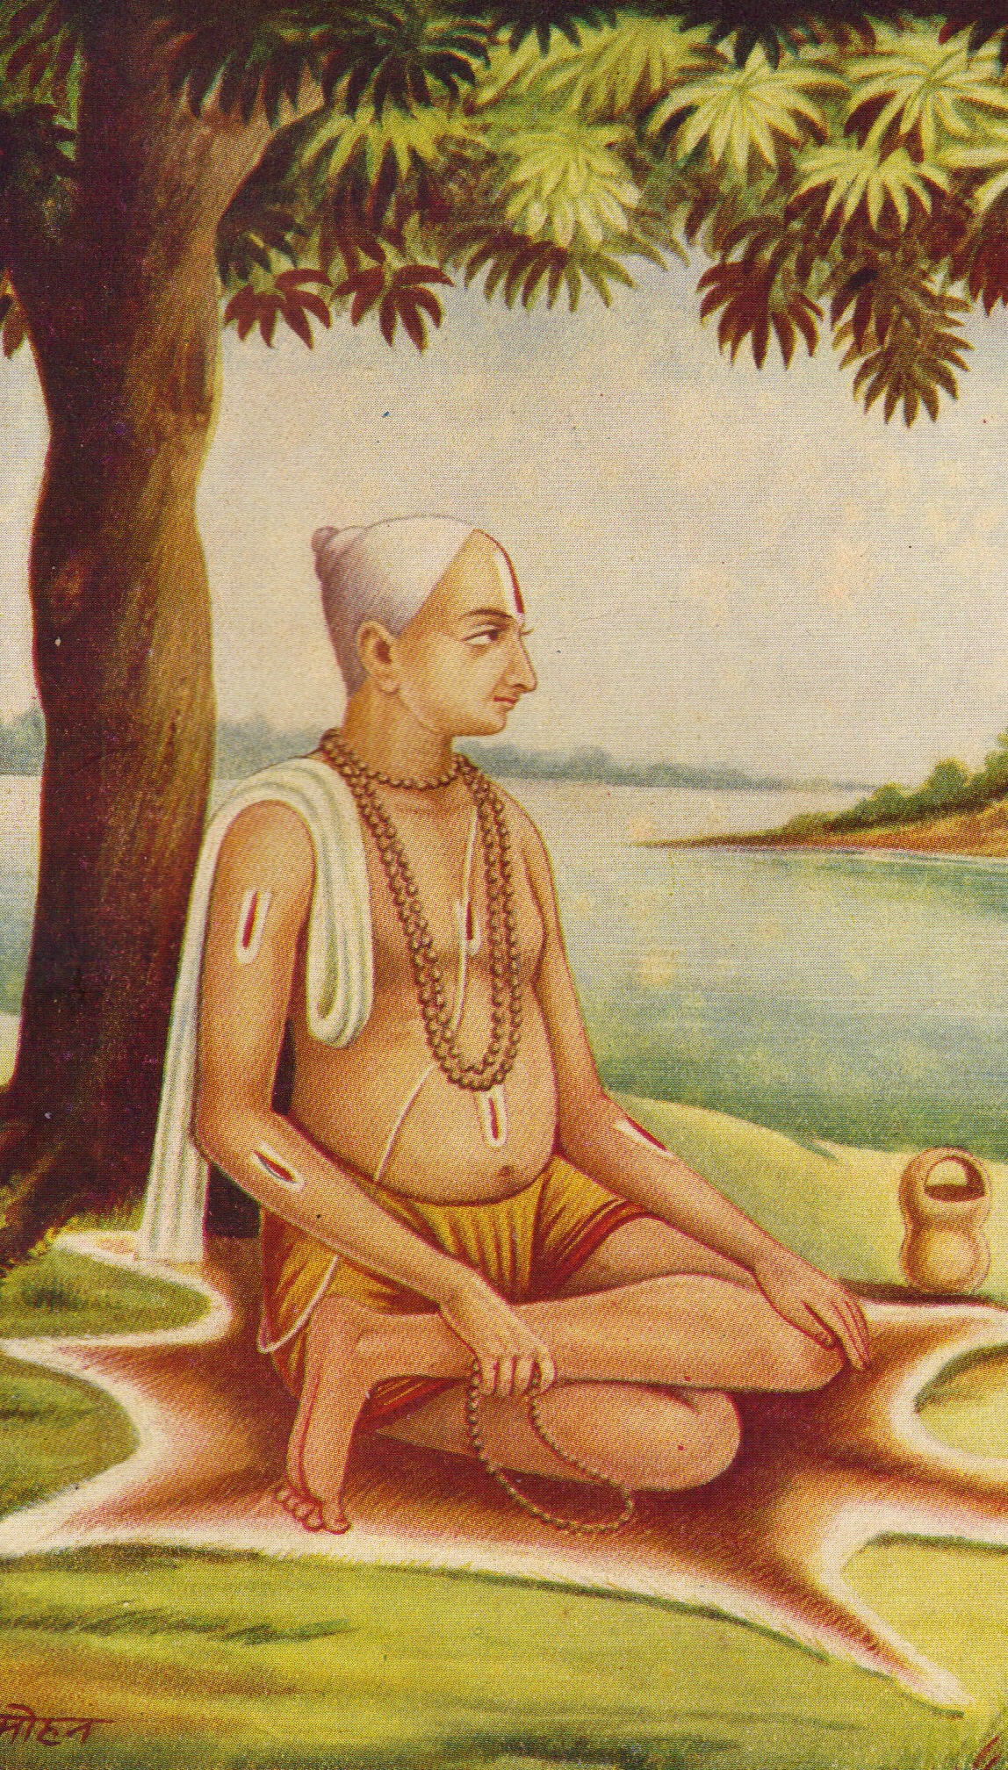
Sant Tulsidas
WPSG Biography Presentation
By : Krishnaraj, Roll 54

Slide 2
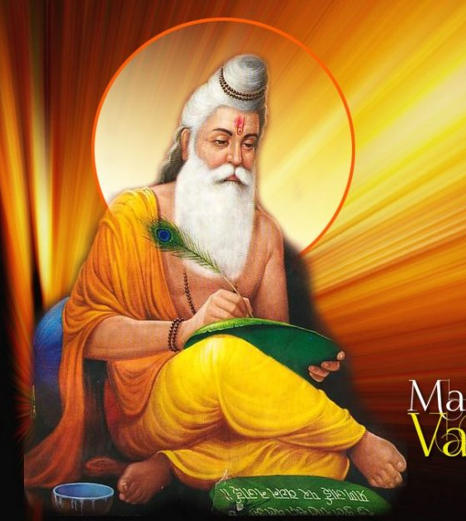
Maharishi Valmaki
Maharishi Valmiki is the first person to have written the Story of Lord Shree Ram – The Ramayan in Sanskrit.
It is believed that Sant Tulsidas is the incarnation of Maharishi Valmiki

Slide 3
Early Life
Sant Tulsidas was born on the 7th day in the month of Shraavana somewhere around the year 1532. His birthplace is identified at the Rajapur (also known as the Chitrakuta) at the bank of the Yamuna river in Uttar Pradesh, India. His parents were Hulsi and Atmaram Dubey.
Upon his birth, he had started enchanting the name of Rama instead of crying. Which is why he was named Rambola. At the fourth night after his birth, his father passed away, and his mother abandoned him soon after.
Sant Tulsidas

Slide 4
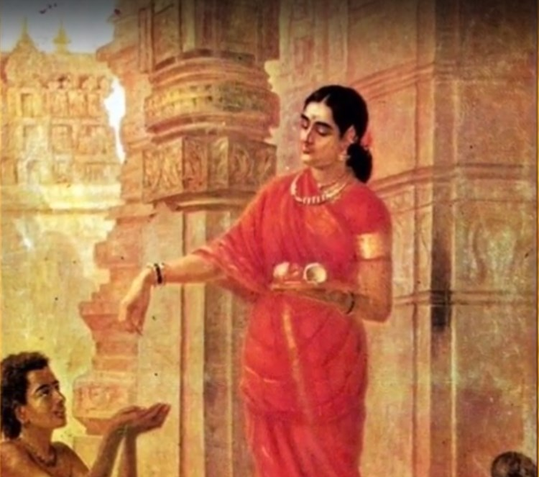
Growing up
Subsequently, Chuniya, the maid of the house had taken him for his own to her town Haripur, where he was brought up. Unfortunately, she was only around for him for about 5 and a half years, after which he had to live his life as an orphan.
It is said in folklore that the Goddess Parvati took up the form of a Brahmin for taking care of the Rambola.

Slide 5
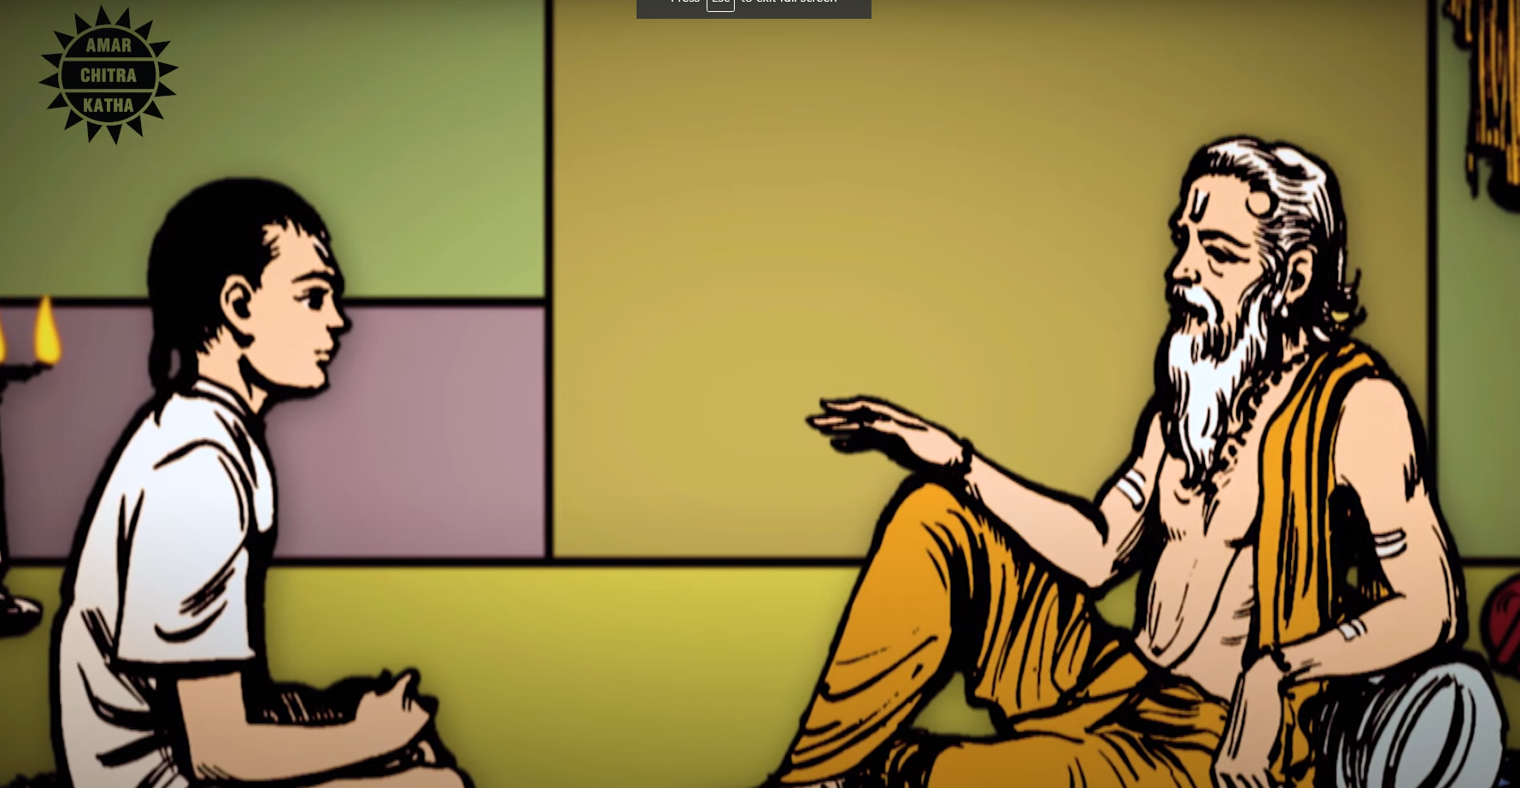
The Name Tulsidas
At the age of six, Rambola was adopted by Narharidas, a Vaishnava ascetic of Ramananda’s monastic order

Slide 6
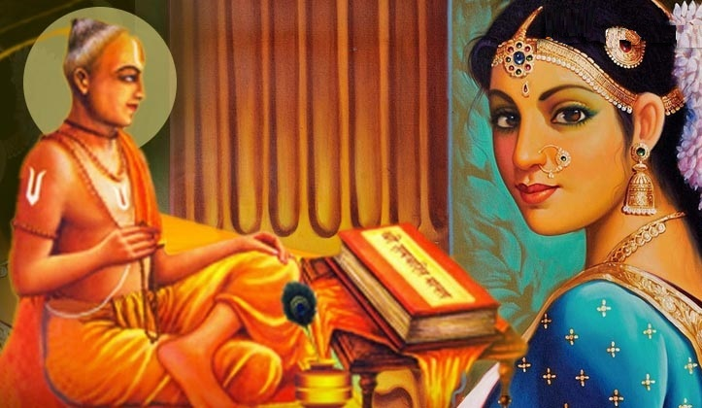
Marriage – The Turning Point
He was married to his wife Ratnavali in the year 1583.
His marriage to her was one of the most important events in his life, as it was what shaped the rest of his journey.
Tulsidas was passionately attached to his wife. He could not bear even a day’s separation from her.

Slide 7
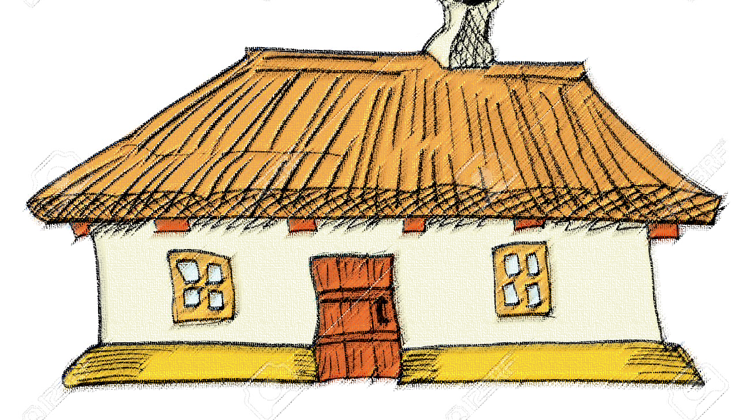

Slide 8
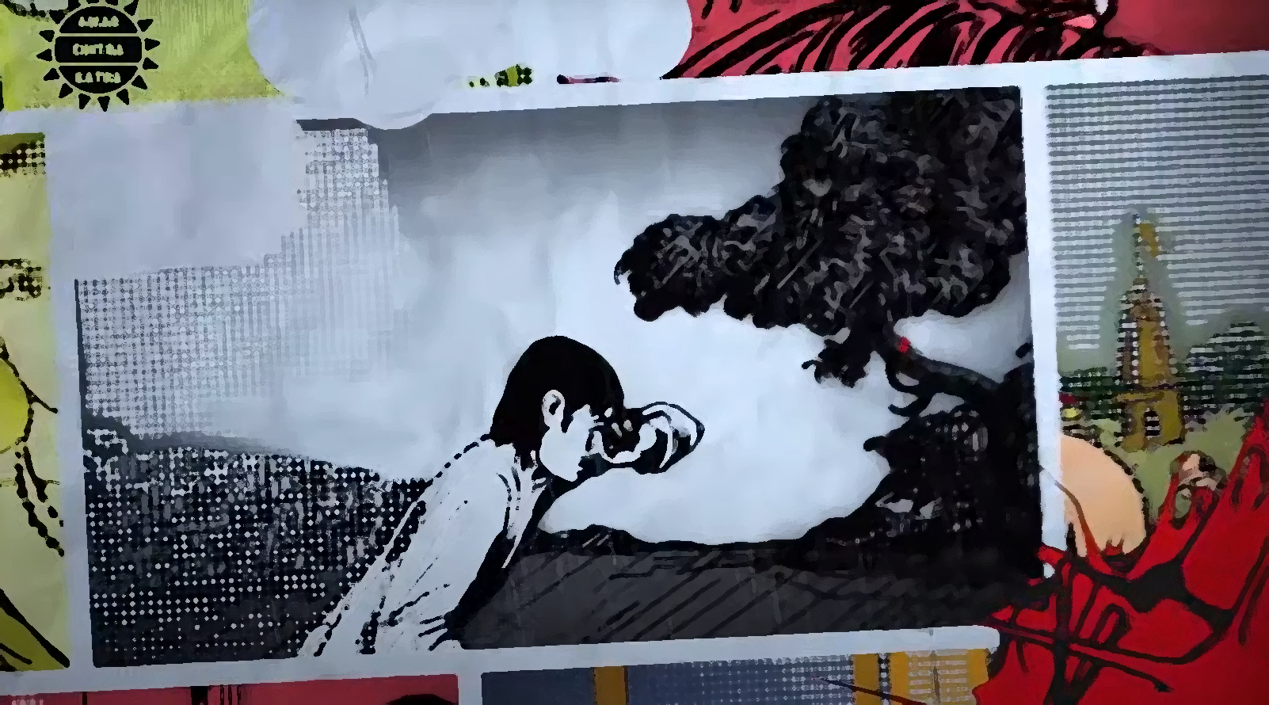

Slide 9
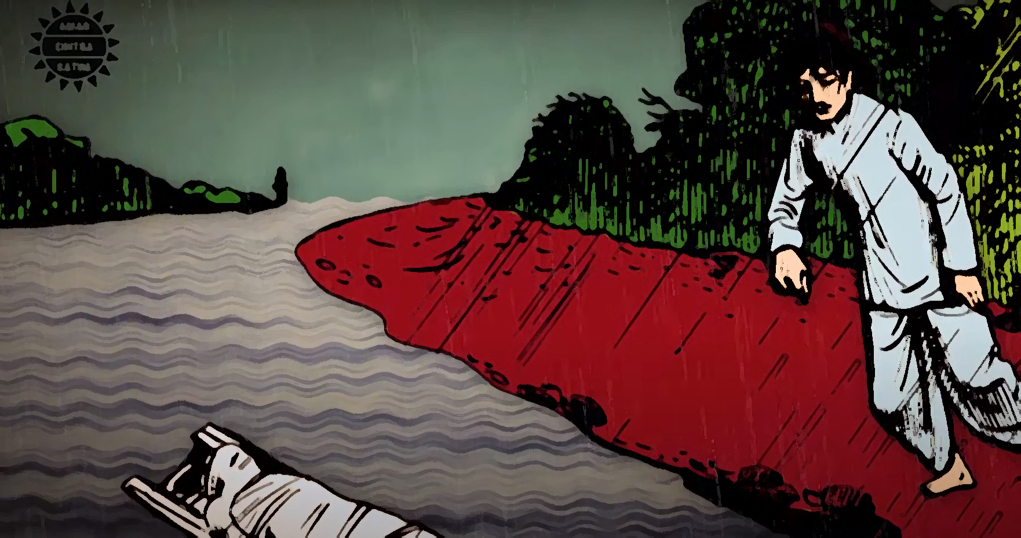

Slide 10
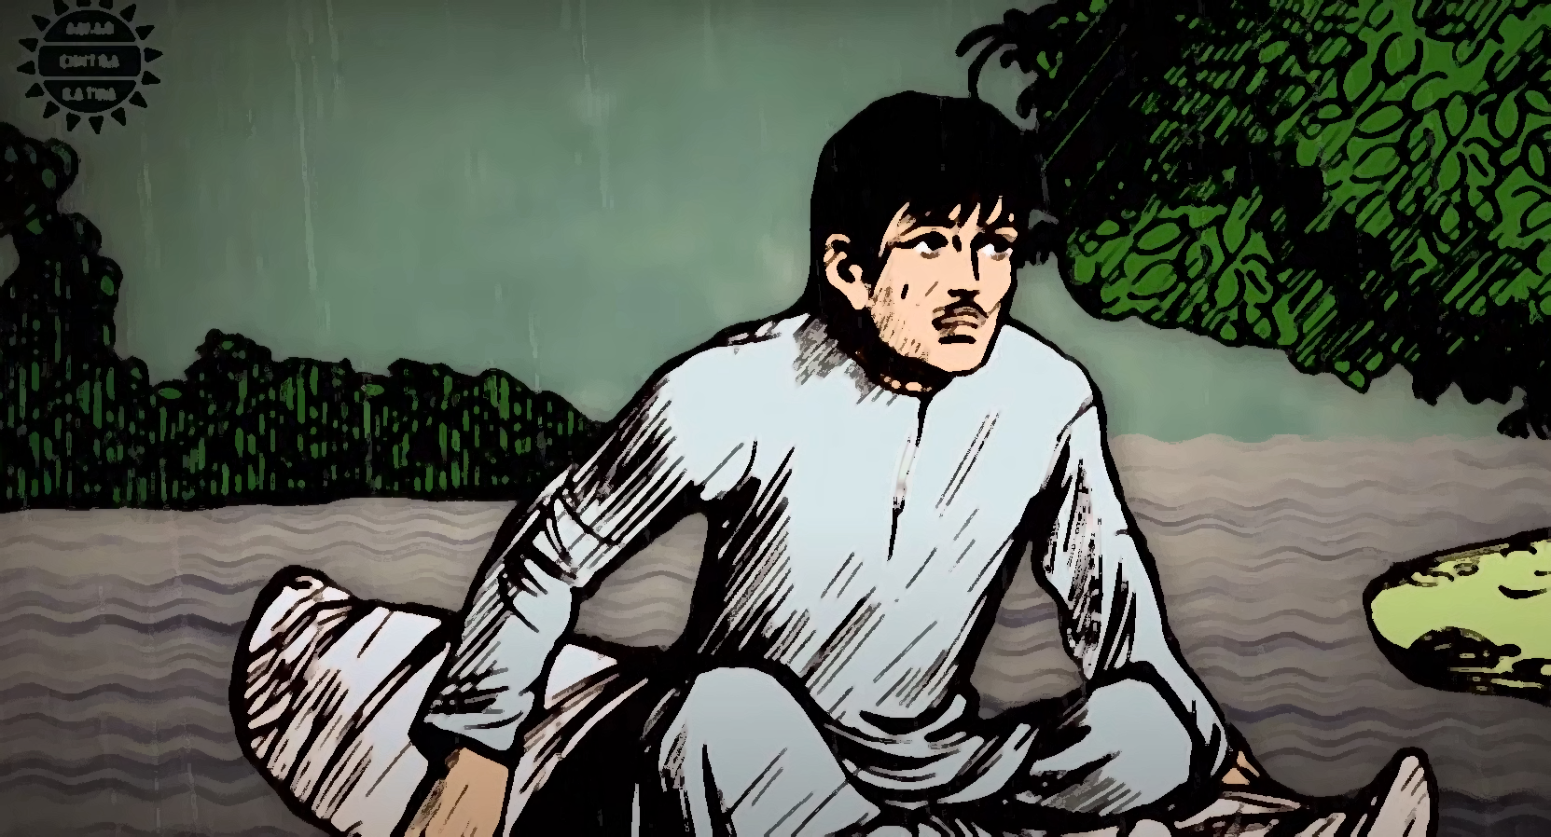

Slide 11
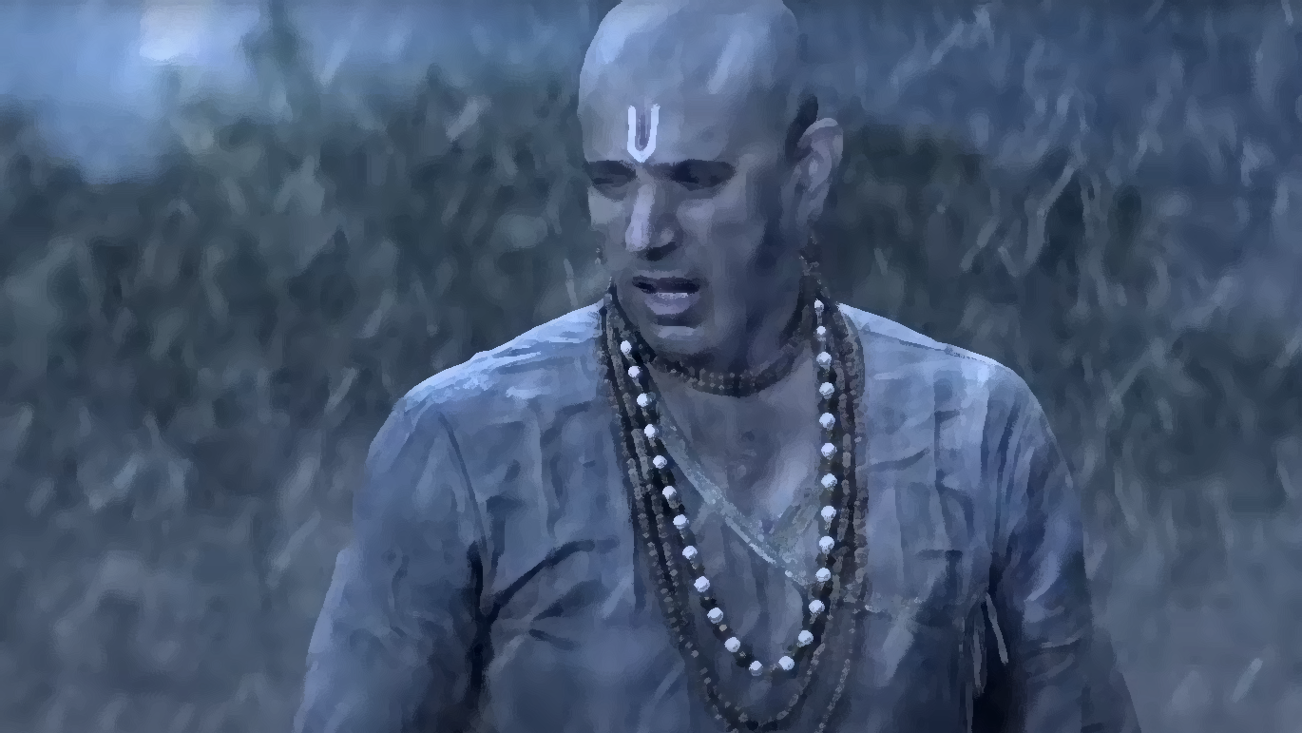

Slide 12
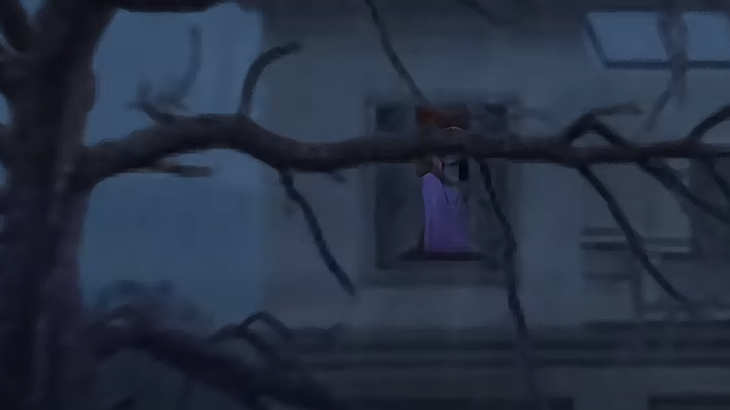

Slide 13
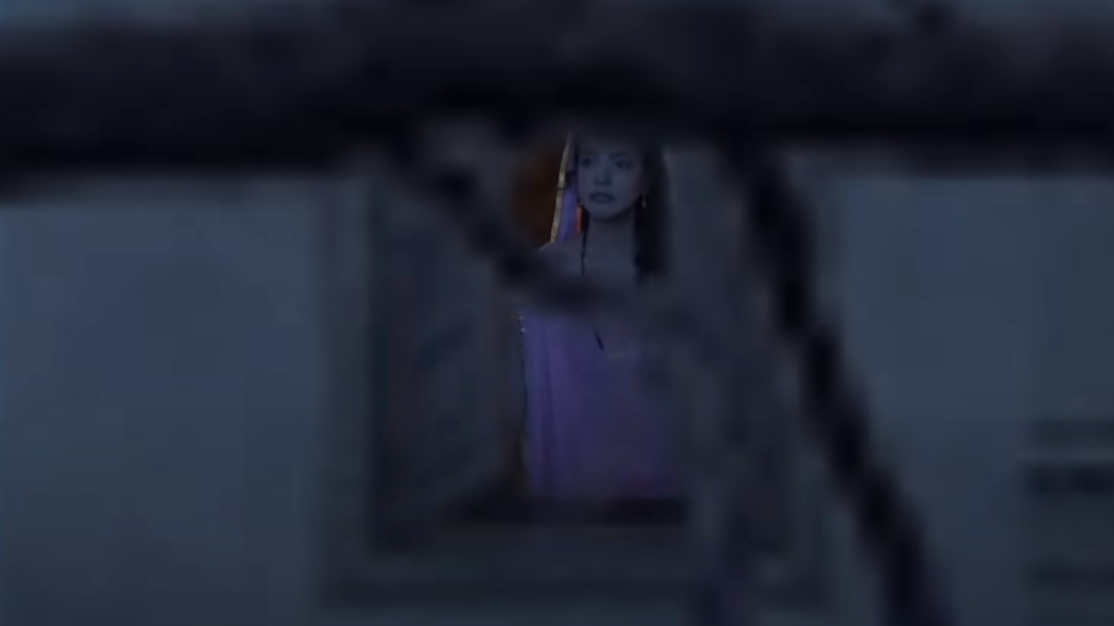

Slide 14
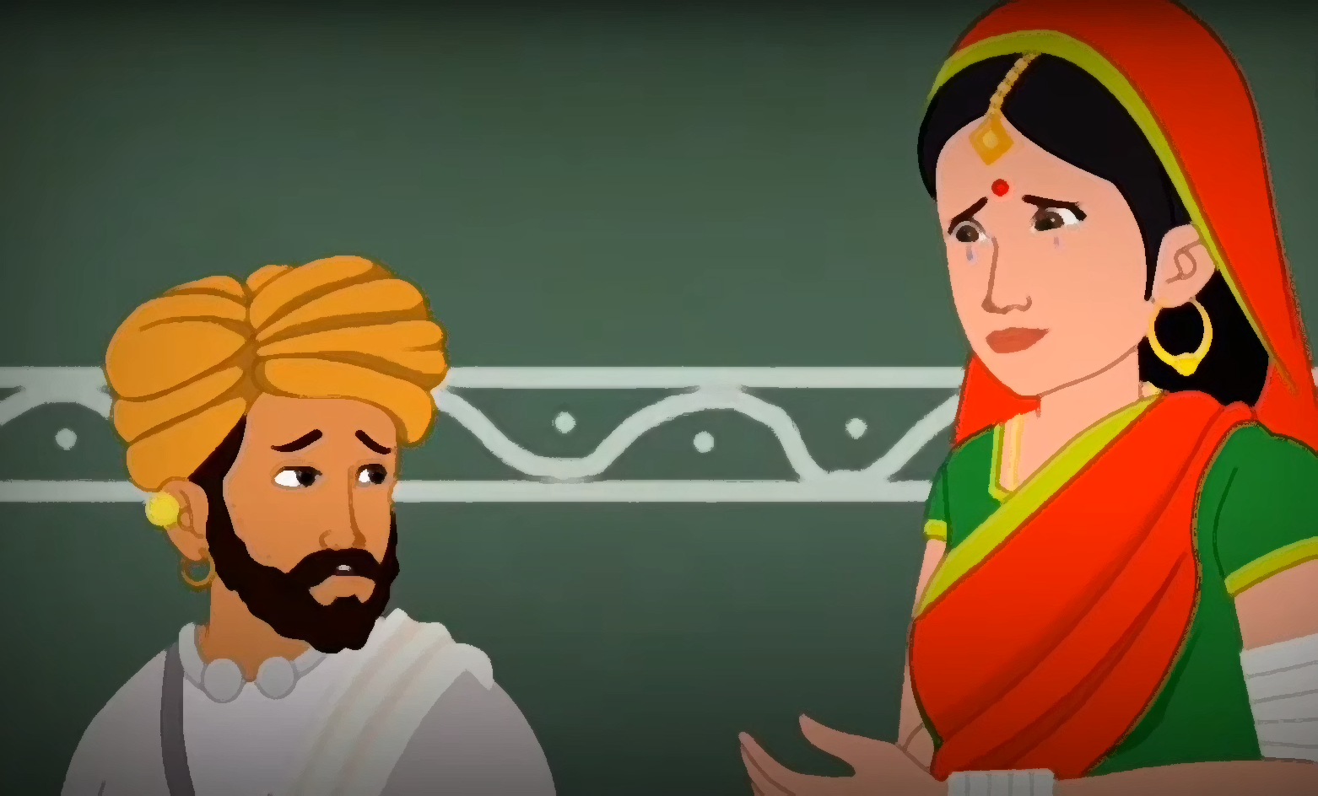

Slide 15
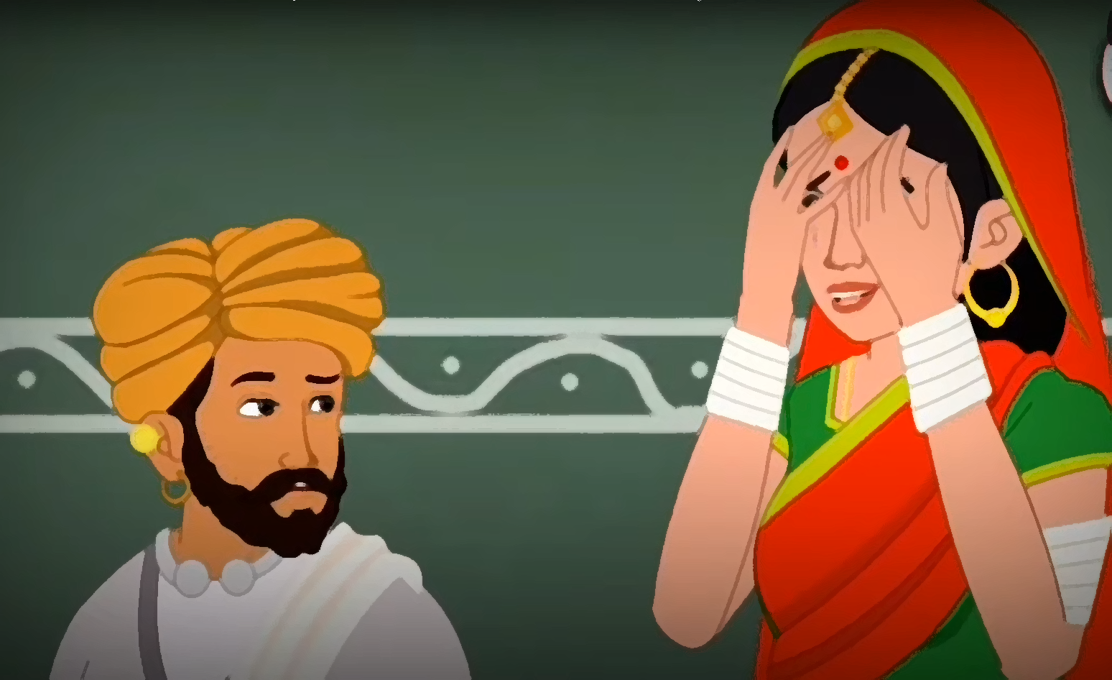

Slide 16
She Said :
“My body is but a network of flesh and bones. If you would develop for Shri Rama even half the love that you have for me, you would certainly cross the ocean of Samsara and attain immortality and eternal bliss”.

Slide 17
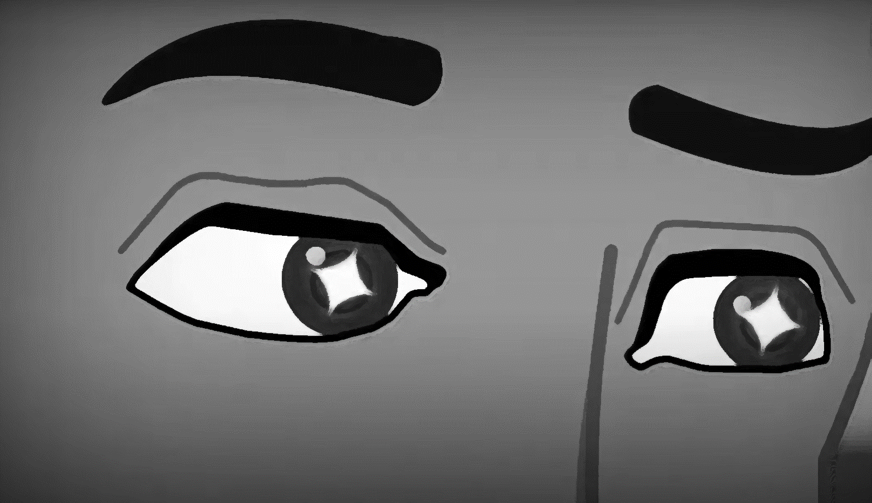

Slide 18
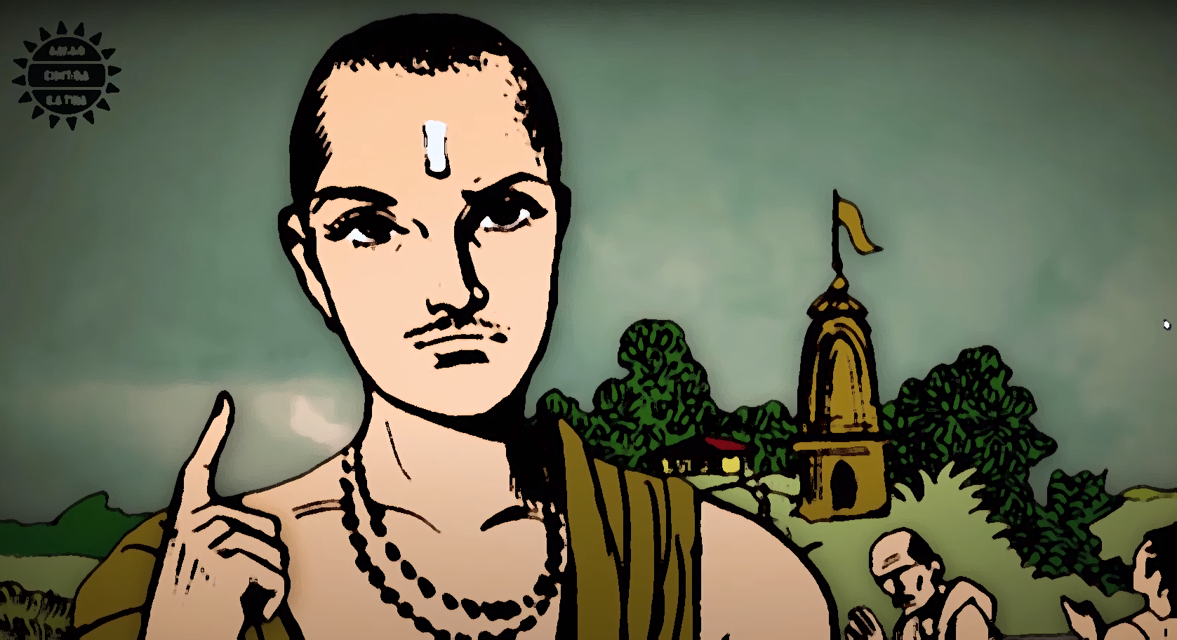

Slide 19
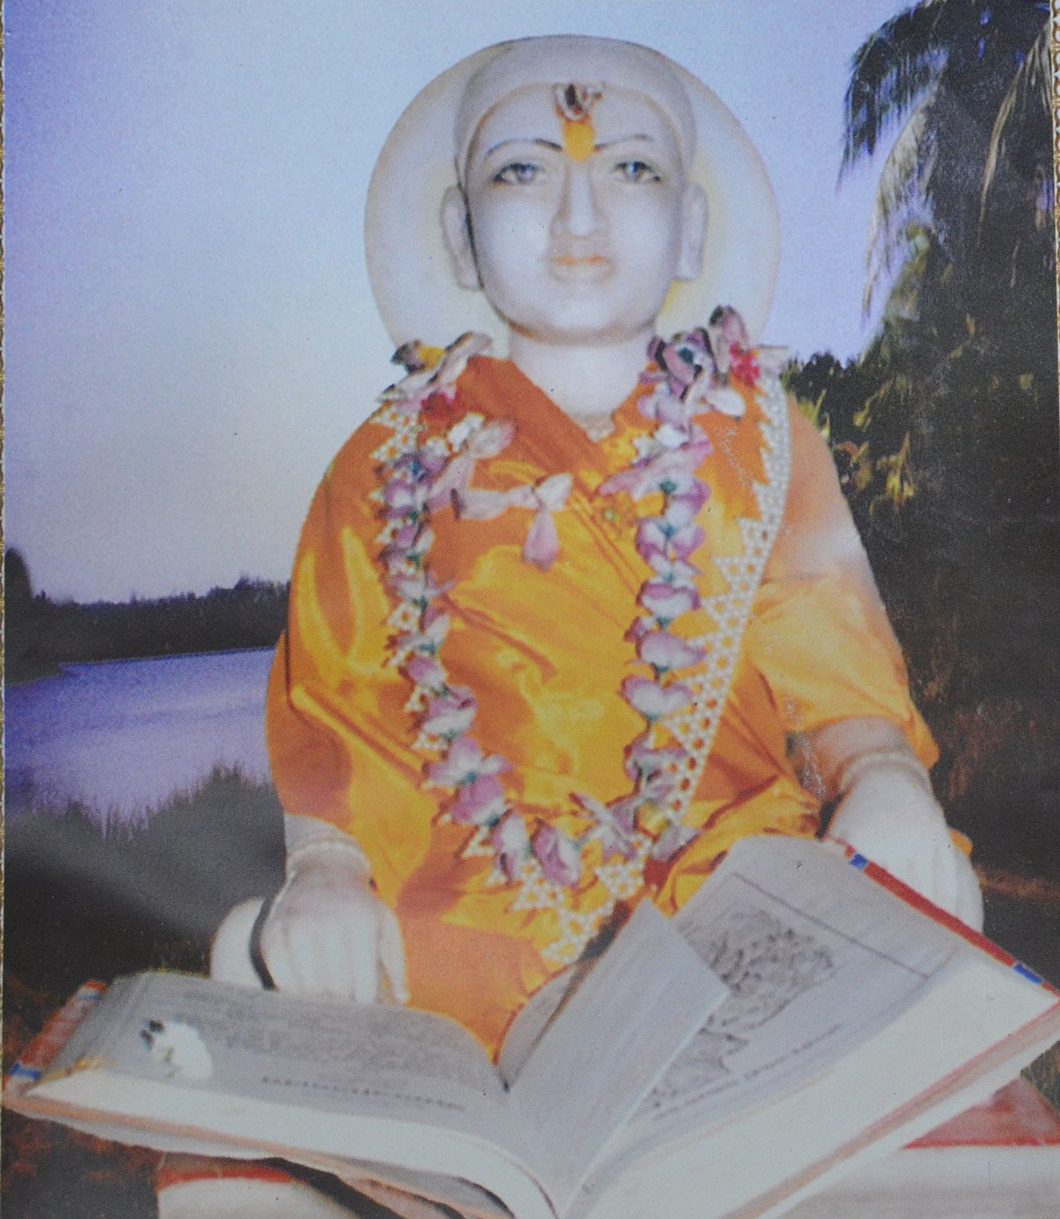
The Path to his work
Tulsidas started composing poetry in Sanskrit in Varanasi on the Prahlada Ghat. Tradition holds that all the verses that he composed during the day, would get lost in the night. This happened daily for eight days.
On the eighth night, Shiva – whose famous Kashi Vishwanath Temple is located in Varanasi – is believed to have ordered Tulsidas in a dream to compose poetry in the vernacular instead of Sanskrit.
Tulsidas woke up and saw both Shiva and Parvati who blessed him. Shiva ordered Tulsidas to go to Ayodhya and compose poetry in Awadhi. Shiva also predicted that Tulsidas' poetry would fructify like the Sama Veda.

Slide 20
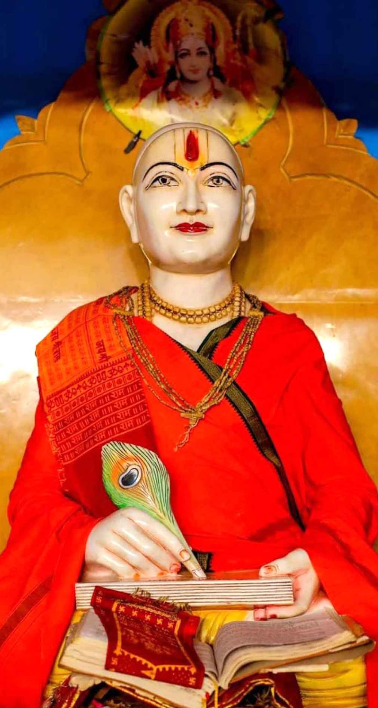
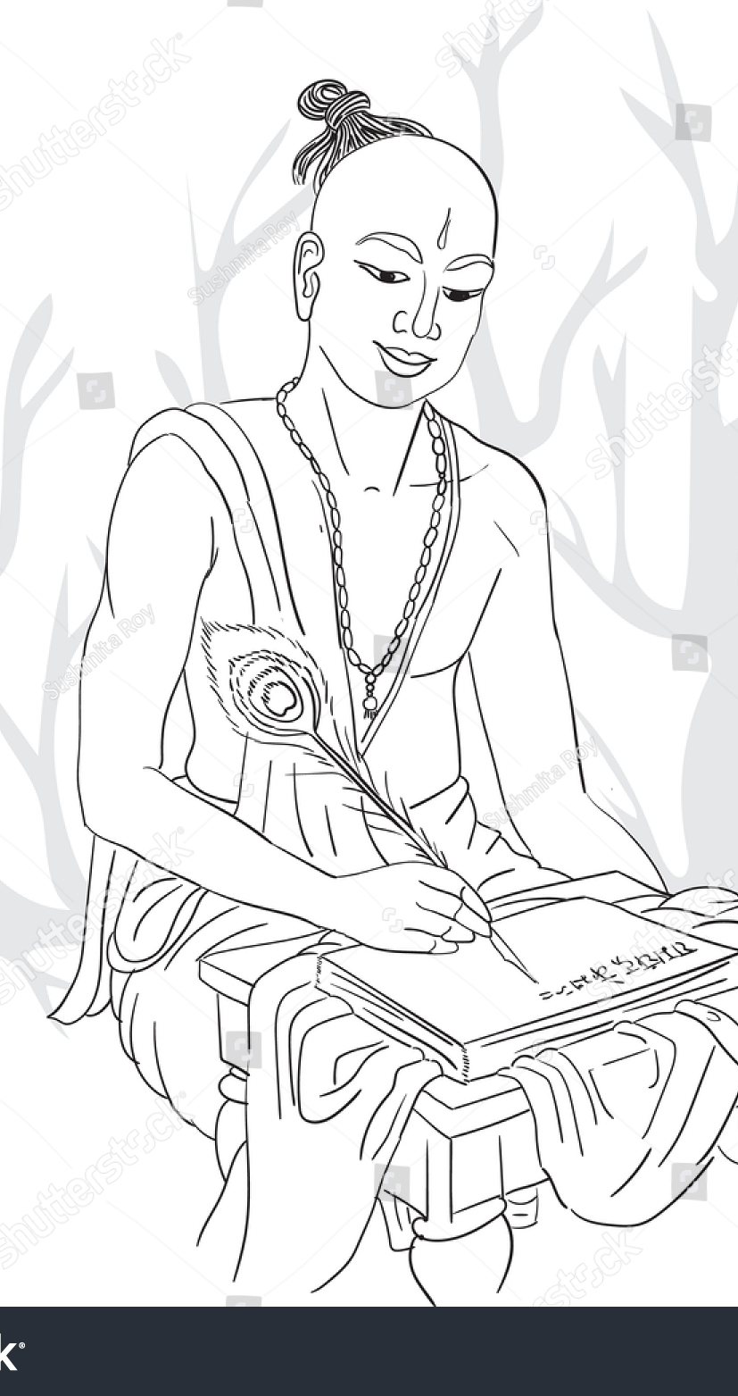
List of more works
The five major works of Tulsidas apart from Ramcharitmanas include: 1. Dohavali (1581), literally Collection of Dohas, is a work consisting of 573 miscellaneous Doha and Sortha verses mainly in Braja with some verses in Awadhi. 2. Sahitya ratna or ratna Ramayan (1608–1614), - Collection of Kavittas 3. Gitavali, Collection of Songs, is a Braja rendering of the Ramayana in songs 4. Krishna Gitavali or Krishnavali (1607), Collection of Songs to Krishna, is a collection of 61 songs in honour of Krishna in Braja. 5. Vinaya Patrika, literally Petition of Humility, is a Braja work consisting of 279 stanzas or hymns. The stanzas form a petition in the court of Rama asking for Bhakti. It is considered to be the second best work of Tulsidas after the Ramcharitmanas.

Slide 21
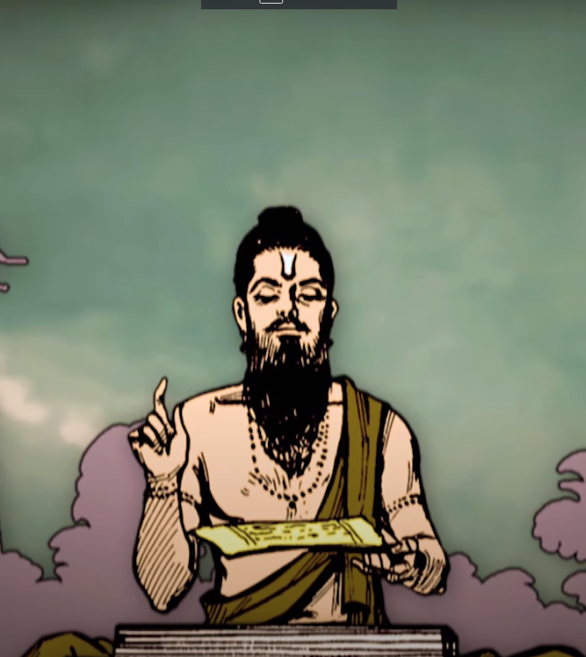
Contribution to Humanity
Materialistically speaking, Sant Tulsidas’ Contributions to Humanity would be the Ramacharitmanas, along with the above-mentioned texts of literature, filled with immense devotion. But his contribution far exceeds the textual work.
In translating the various scriptures of Hindu literature from Sanskrit to the vernacular language, he opened the door to knowledge, Devotion and enlightenment to a very large demographic.
The people that did not know Sanskrit, to those that were at that time not allowed to read or write, could now all listen, recite and even dedicate their entire lives reading, appreciating and absorbing the works of Tulsidas.

Slide 22
To our households…
This effect was naturally carried down the generations, and in the past 400 years, has and will benefit the lives of countless people. The result of his translation was that every household in India could now experience the highest form of Literature and Manuscripts that were previously out of their reach.
This kindled the idea of devotion, and respect in the minds and households of Each Indian, effectively changing his or her life for ever, and this effect will continue for the generations to come.

Slide 23
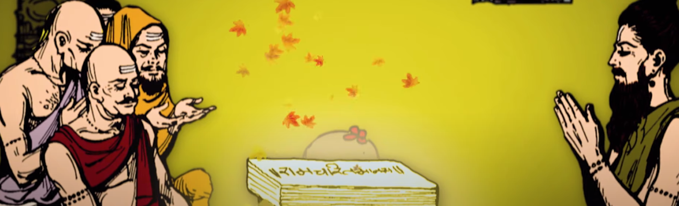
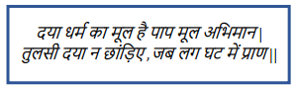
What we should learn
From a person like Sant Tulsidas, There is a plethora of things to learn. Most of them solely from the Tulasi Satsai, where he writes dohas about the lessons that he has learnt from his life. A personal favorite of mine is:
It states that a person must never stop being kind, no matter where life takes him. It is a saying, which I believe to be the essence of good character in humans, which if cultivated, could help make this world a much better place.
Other things to learn from Sant Tulsidas are his unending devotion, his character to never criticise his life no matter how tough it got, and the fact that if we channel our passion towards the right thing, something great will always come out of it.

Slide 24
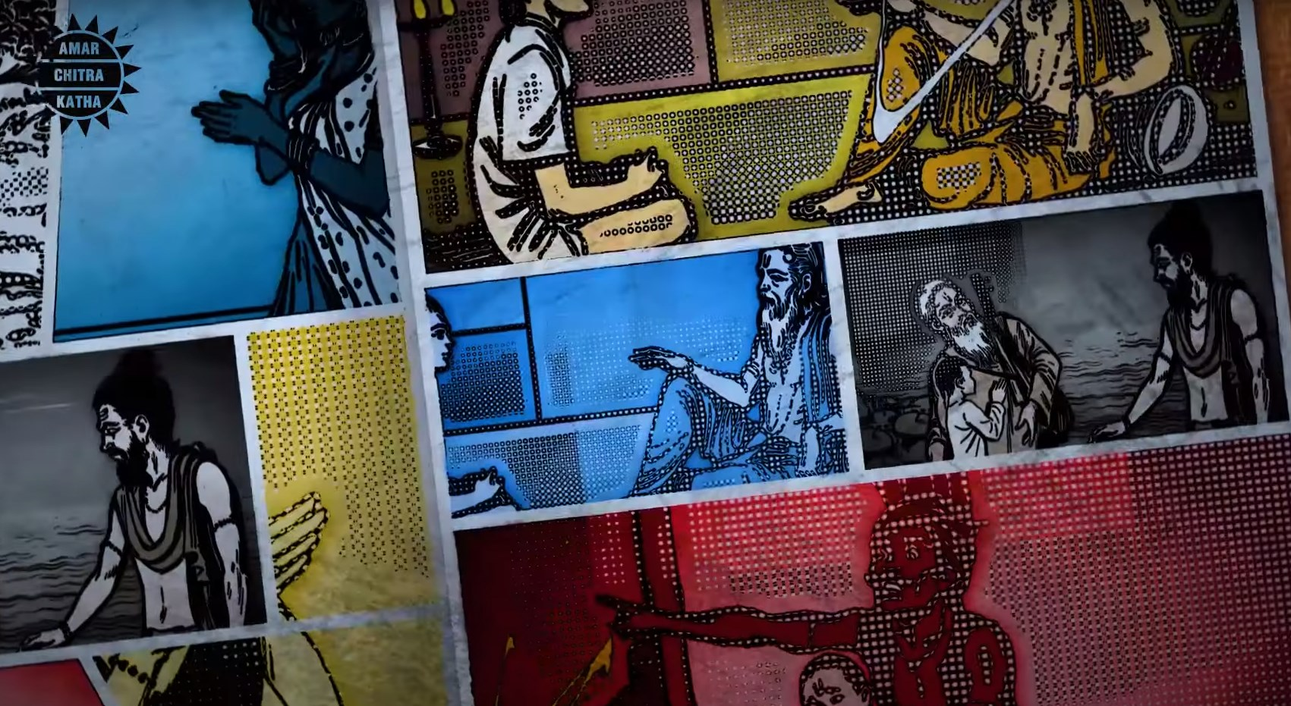
Summary
Sant Tulsidas was born in the year 1532 and had immediately begun chanting the name of Lord Rama. He had a very rough childhood and grew up mostly as an orphan from the age of 5 and is believed by many to have been the reincarnation of the great Sage Valmaki himself.
Marriage was perhaps the most important guiding event in his life that led him to the path that he was meant to choose. He soon became an ascetic and spent the rest of his life in devotion. He ultimately found his goal and met Lord Hanuman himself.
He went on to translate the Ramayan from Sanskrit, along with many other holy scriptures into the vernacular language – Awadhi.
He was truly a saint that transformed the way we see and hear our scriptures and brought them to our households.

